Slide 1
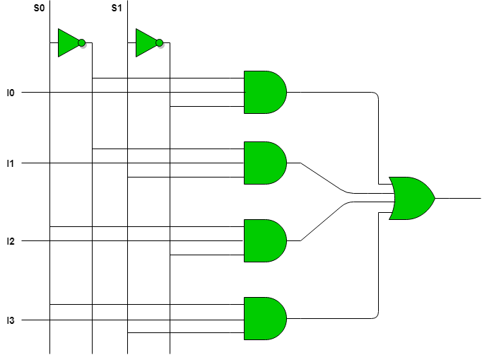

Mux It Up
Group 4: Will Krska, Ryan Smith, Ammar Hussain, Alex Zhou
Image sources: https://www.geeksforgeeks.org/multiplexers-in-digital-logic/
https://www.explorebigsky.com/mix-it-up-springtime-delights/25049

Slide 2

Goal/Motivation
In an education saturated with STEM, we wanted to spice things up and make it more fun. We wanted to make music!
Our goal was to create a guitar on the FPGA that incorporated switches, buttons, VGA output, and sound output.
While simple in concept, it would be a good exercise in utilizing the diverse functionality of an FPGA.
A comprehensive way to recap all the skills learned in lab this semester.
Image Source: https://www.vecteezy.com/music/31144-modern-music-notes-vector-pack

Slide 3
Short Functionality
We use the 16 switches to represent the frets on a guitar neck. By the nature of how a “guitar string” works, only the lowest switch should be considered for tone generation.
We use 4 of the buttons available to use as our strings. Pressing a button strums that string.
With that, we display on VGA the held fret and the strummed string. We also output the corresponding tone to that fret and string combination.

Slide 4
Short Specification
Requirements included:
Decoder to interpret button and switch inputs into correct tone output
Tuner to help outline the half-note steps for each possible guitar sound output
Logic that prioritizes lowest switch input; not have many tones at once
Able to display guitar strings and frets on VGA
Sound output frequencies needs to be accurate as well
Constraints included:
Sixteen switches on FPGA
Only lower four strings of guitar could be represented

Slide 5
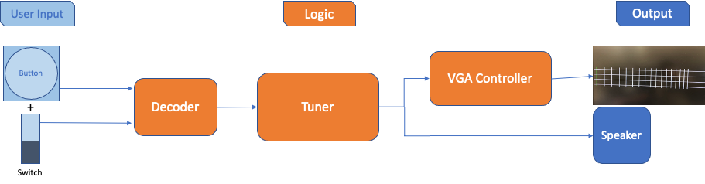
Block Diagram

Slide 6
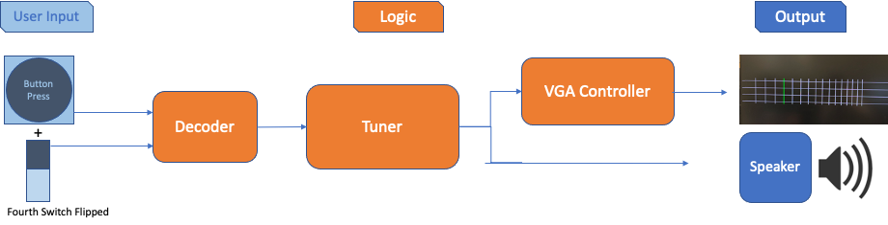
Block Diagram

Slide 7
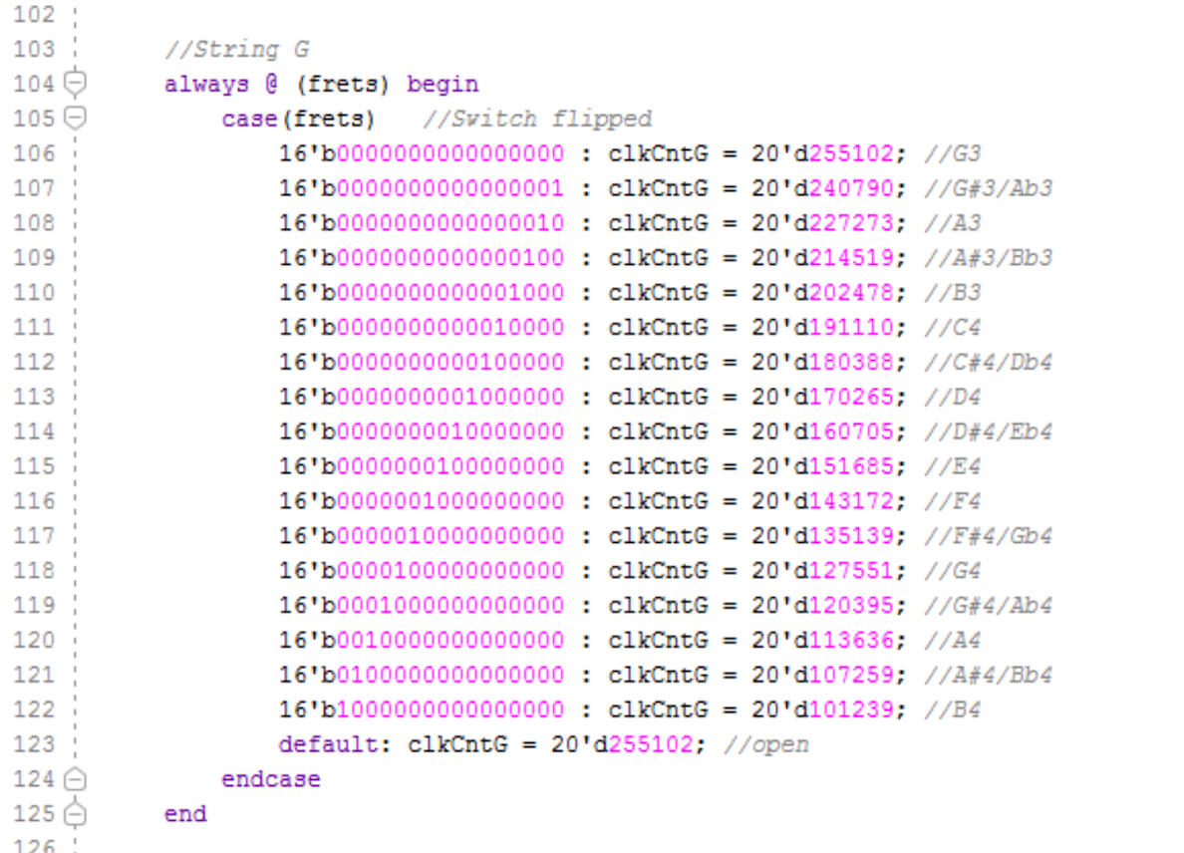
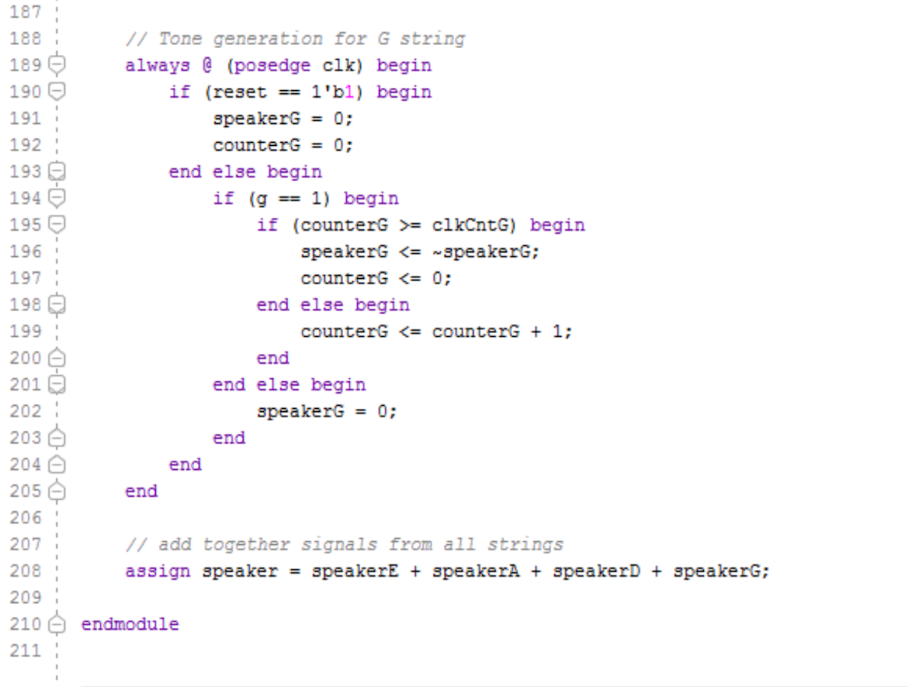
Code Snippet - tone generation
First block: takes one-hot fret encoding, sets clock divisor
Second block: divides board clock by appropriate value
Third block: combines output from E, A, C, and G-string to allow multi-tonal playback

Slide 8
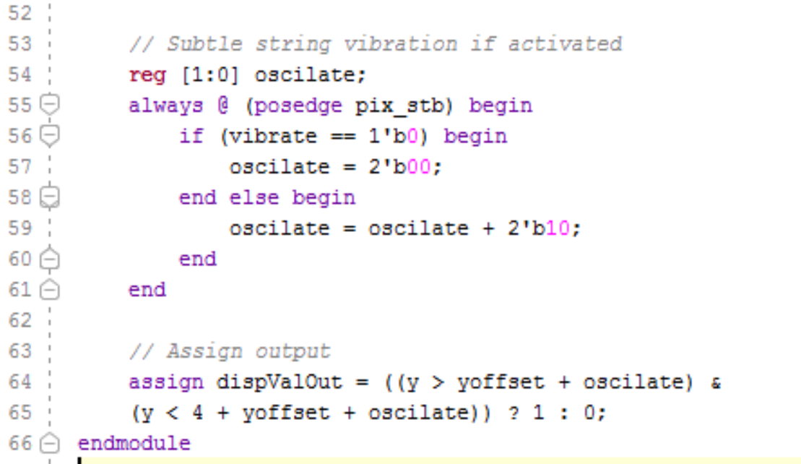
Code Snippet - strings
When button is pressed (“vibrate”), y-coordinate will be oscillated up and down by 2 pixels.

Slide 9
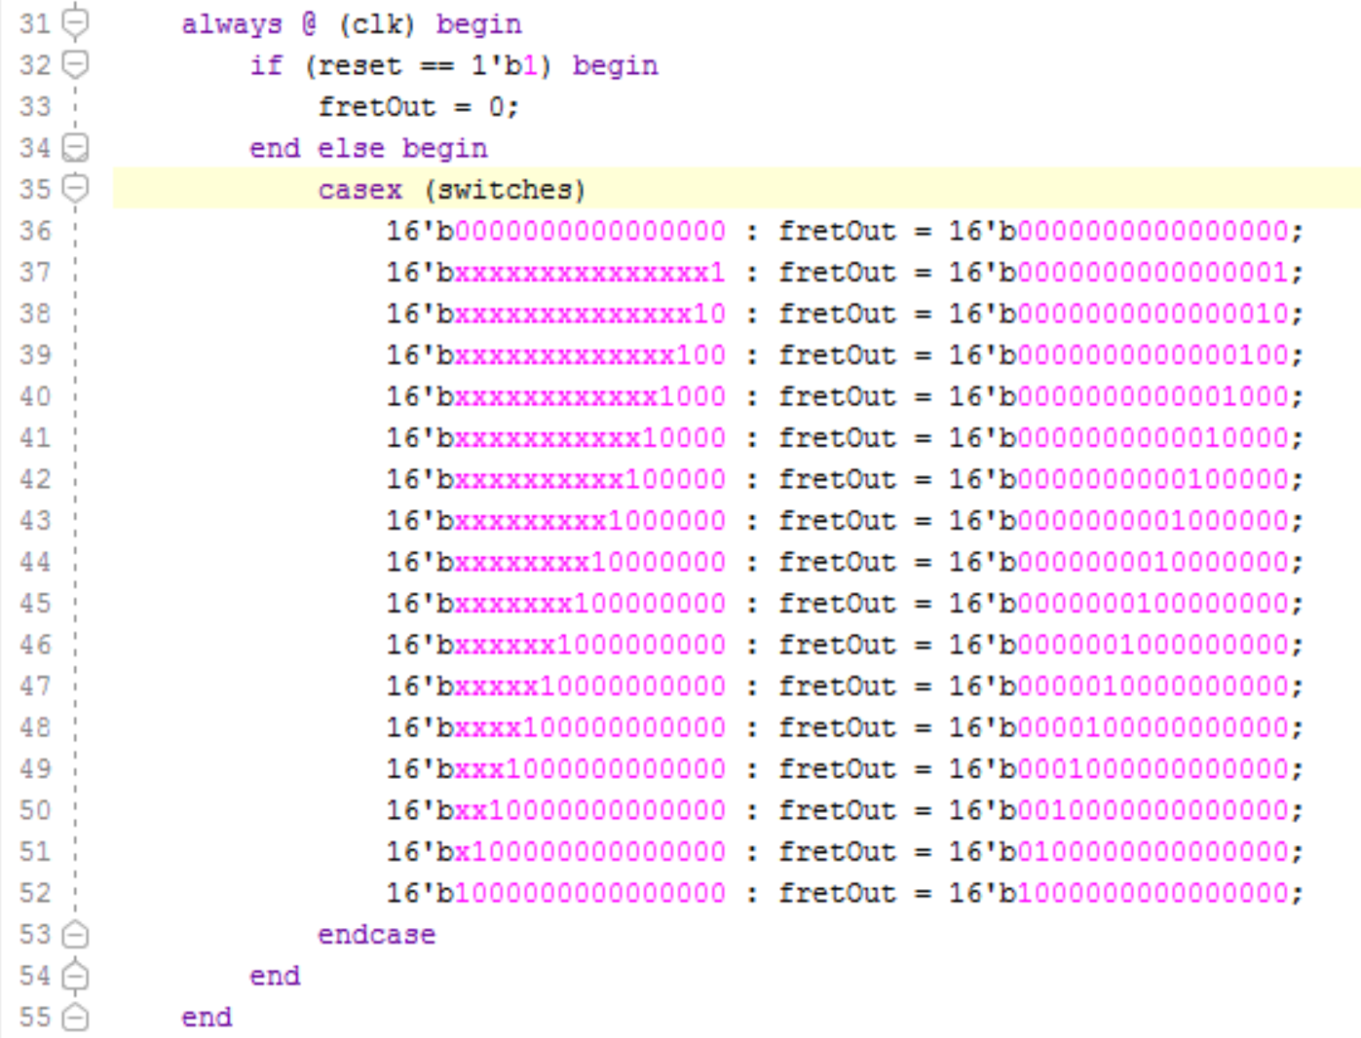
Code Snippet - decoder
Used a casex to isolate lowest switch
Doesn’t matter what switch combination, only sends lowest “fret” out to tone generator and VGA display

Slide 10

Successes
Guitar string and fret display on the VGA
Vibrating strings
Illumination of frets
Sound quality
Differing tones in strings and frets
Usability of strings and frets
Multiple strings can be played at a time
Only lowest fret is played

Slide 11
Failures
Difficulties:
Many different tones made logic cumbersome
Same sound frequencies but not actual guitar sound
Correlation between switches and frets
Future hypothetical additions:
With more inputs, all 6 strings, and allow for different frets on different strings
Add in pre-programmed tunes, “Jukebox mode”

Slide 12

Thank You!

